Slide 1
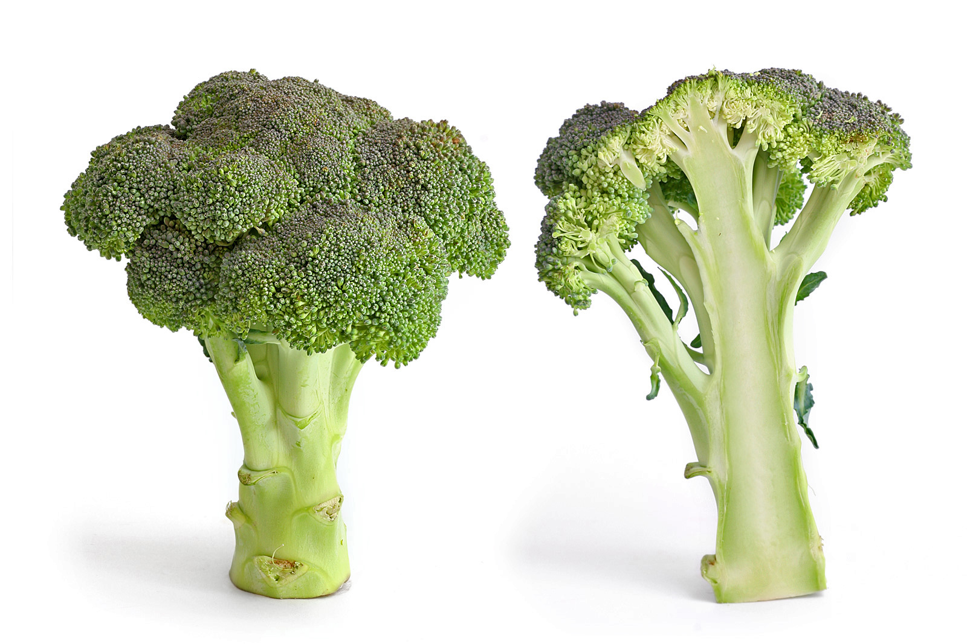
CS61B
Lectures 38: Compression
Prefix Free Codes
Huffman Coding
Theory of Compression
LZW (Extra)
Lossy Compression (Extra)

Slide 2
Zip Files, How Do They Work?
$ zip mobydick.zip mobydick.txt
adding: mobydick.txt (deflated 59%)
$ ls -l
-rw-rw-r-- 1 jug jug 643207 Apr 24 10:55 mobydick.txt
-rw-rw-r-- 1 jug jug 261375 Apr 24 10:55 mobydick.zip
Size in Bytes
$ unzip mobydick.zip
replace mobydick.txt? [y]es, [n]o, [A]ll, [N]one, [r]ename: r
new name: unzipped.txt
inflating: unzipped.txt
$ diff mobydick.txt unzipped.txt
$
File is unchanged by zipping / unzipping.
Notes:
what sorcery is this

Slide 3
Compression Model #1: Algorithms Operating on Bits
Bitstream B
Compressed bits C(B)
Compression
Algorithm C
01010101000001010101110...
1001010101...
C(B)
B
Decompression
Algorithm C⁻¹
1001010101...
01010101000001010101110...
In a lossless algorithm we require that no information is lost.
Text files often compressible by 70% or more.

Slide 4
Prefix Free Codes

Slide 5
Increasing Optimality of Coding
By default, English text is usually represented by sequences of characters, each 8 bits long, e.g. ‘d’ is 01100100.
Easy way to compress: Use fewer than 8 bits for each letter.
Have to decide which bit sequences should go with which letters.
More generally, we’d say which codewords go with which symbols.
word | binary | hexadecimal
dog | 01100100 01101111 01100111 | 64 6f 67

Slide 6
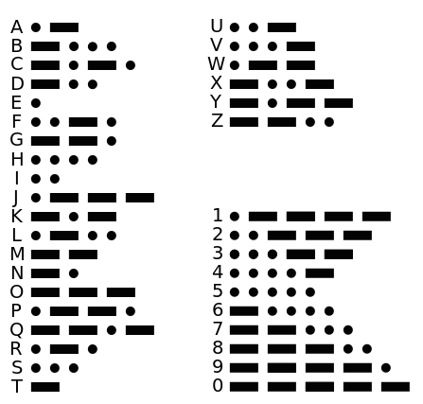
More Code: Mapping Alphanumeric Symbols to Codewords
Example: Morse code.
Goal: Compact representation.
What is – – • – – •?

Slide 7
More Code: Mapping Alphanumeric Symbols to Codewords
Example: Morse code.
Goal: Compact representation.
What is – – • – – •? It’s ambiguous!
MEME
GG
Note:
Can think of dot as 0, dash as 1.
Operators pause between codewords to avoid ambiguity.
Pause acts as a 3rd symbol.
Alternate strategy: Avoid ambiguity by making code prefix free.

Slide 8
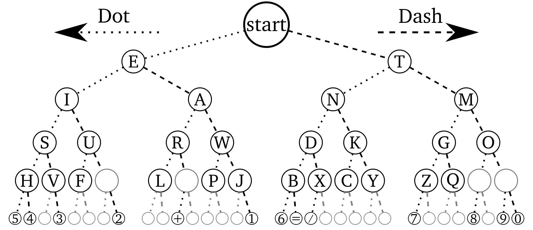
Morse Code (as a Tree)
From Wikimedia

Slide 9
Prefix-Free Codes [Example 1]
A prefix-free code is one in which no codeword is a prefix of any other. Example for English:
0
1
start
0
1
space | 1
E | 01
T | 001
A | 0001
O | 00001
I | 000001
...
space
0
1
E
0
1
T
0
1
A
0
1
O
0
1
I ATE: 0000011000100101
I
...

Slide 10
Prefix-Free Codes [Example 2]
A prefix-free code is one in which no codeword is a prefix of any other. Example for English:
0
1
start
space | 111
E | 010
T | 1101
A | 1011
O | 1001
I | 1000
...
0
1
0
1
0
1
...
0
1
0
1
0
1
E
...
space
0
1
0
1
0
1
...
...
I
O
A
T
I ATE: 100011110111101010

Slide 11
Prefix Free Code Design
Observation: Some prefix-free codes are better for some texts than others.
Better for EEEEAT (8+3+4 = 15 bits).
space | 1
E | 01
T | 001
A | 0001
O | 00001
I | 000001
...
Worse for EEEEAT (12+4+4 = 20 bits).
space | 111
E | 010
T | 1101
A | 1011
O | 1001
I | 1000
...
Much worse for JOSH (25+5+8+10 = 48 bits).
Better for JOSH (7+4+6+6 = 23 bits).
Observation: It’d be useful to have a procedure that calculates the “best” code for a given text.

Slide 12
Shannon Fano Codes (Extra)

Slide 13
Code Calculation Approach #1 (Shannon-Fano Coding)
Count relative frequencies of all characters in a text.
Split into ‘left’ and ‘right halves’ of roughly equal frequency.
Left half gets a leading zero. Right half gets a leading one.
Repeat.
Symbol | Frequency
我 | 0.35
爸 | 0.17
是 | 0.17
李 | 0.16
刚 | 0.15
35% of all characters are 我
Left half
我
爸
是
李
刚
Right half

Slide 14
Code Calculation Approach #1 (Shannon-Fano Coding)
Count relative frequencies of all characters in a text.
Split into ‘left’ and ‘right halves’ of roughly equal frequency.
Left half gets a leading zero. Right half gets a leading one.
Repeat.
Symbol | Frequency | Code
我 | 0.35 | 0...
爸 | 0.17 | 0...
是 | 0.17 | 1...
李 | 0.16 | 1...
刚 | 0.15 | 1...
Left half
0
1
我
爸
是
李
刚
Right half

Slide 15
Code Calculation Approach #1 (Shannon-Fano Coding)
Count relative frequencies of all characters in a text.
Split into ‘left’ and ‘right halves’ of roughly equal frequency.
Left half gets a leading zero. Right half gets a leading one.
Repeat.
Symbol | Frequency | Code
我 | 0.35 | 00
爸 | 0.17 | 01
是 | 0.17 | 1...
李 | 0.16 | 1...
刚 | 0.15 | 1...
Left half
Right half
0
1
是
李
刚
0
1
我
爸

Slide 16
Code Calculation Approach #1 (Shannon-Fano Coding)
Count relative frequencies of all characters in a text.
Split into ‘left’ and ‘right halves’ of roughly equal frequency.
Left half gets a leading zero. Right half gets a leading one.
Repeat.
Symbol | Frequency | Code
我 | 0.35 | 00
爸 | 0.17 | 01
是 | 0.17 | 1...
李 | 0.16 | 1...
刚 | 0.15 | 1...
0
1
Left half
是
李
刚
0
1
Right half
我
爸

Slide 17
Code Calculation Approach #1 (Shannon-Fano Coding)
Count relative frequencies of all characters in a text.
Split into ‘left’ and ‘right halves’ of roughly equal frequency.
Left half gets a leading zero. Right half gets a leading one.
Repeat.
Does a good job, but not the best.
Symbol | Frequency | Code
我 | 0.35 | 00
爸 | 0.17 | 01
是 | 0.17 | 10
李 | 0.16 | 11...
刚 | 0.15 | 11...
0
1
Left half
0
1
0
1
Right half
我
爸
是
李
刚

Slide 18
Code Calculation Approach #1 (Shannon-Fano Coding)
Count relative frequencies of all characters in a text.
Split into ‘left’ and ‘right halves’ of roughly equal frequency.
Left half gets a leading zero. Right half gets a leading one.
Repeat.
Does a good job, but not the best.
Symbol | Frequency | Code
我 | 0.35 | 00
爸 | 0.17 | 01
是 | 0.17 | 10
李 | 0.16 | 110
刚 | 0.15 | 111
0
1
0
1
0
1
我
爸
是
0
1
李
刚

Slide 19
Code Calculation Approach #1 (Shannon-Fano Coding)
Shannon-Fano coding is NOT optimal. Does a good job, but possible to find ‘better’ codes (see CS170).
Optimal solution assigned (and solved) as alternative to a final exam: http://www.huffmancoding.com/my-uncle/scientific-american
Symbol | Frequency | Code
我 | 0.35 | 00
爸 | 0.17 | 01
是 | 0.17 | 10
李 | 0.16 | 110
刚 | 0.15 | 111
0
1
0
1
0
1
我
爸
是
0
1
李
刚

Slide 20
Huffman Coding

Slide 21
Code Calculation Approach #2: Huffman Coding
Calculate relative frequencies.
Assign each symbol to a node with weight = relative frequency.
Take the two smallest nodes and merge them into a super node with weight equal to sum of weights.
Repeat until everything is part of a tree.
35% of characters in input are 我.
16% of characters in input are 李.
0.31
0.34
0.31
0
1
0
1
0
1
我
爸
是
李
刚
我
爸
是
李
刚
我
爸
是
李
刚
0.35
0.17
0.17
0.16
0.15
0.35
0.17
0.17
0.35

Slide 22
Code Calculation Approach #2: Huffman Coding
Calculate relative frequencies.
Assign each symbol to a node with weight = relative frequency.
Take the two smallest nodes and merge them into a super node with weight equal to sum of weights.
Repeat until everything is part of a tree.
已经证明是最佳的
1
0.65
1
0
1
0
0
0.34
0.31
0
1
0
1
0
1
0
1
0
1
0
1
我
爸
是
李
刚
我
爸
是
李
刚
我
爸
是
李
刚
0.35
0.35

Slide 23
Efficiency Assessment: http://yellkey.com/start
How many bits per symbol do we need to compress a file with the character frequencies listed below using the Huffman code that we created?
A. (1*1 + 4*3) / 5
= 2.6 bits per symbol
B. (0.35) * 1 + (0.17 + 0.17 + 0.16 + 0.15) * 3
= 2.3 bits per symbol
C. Not enough information, we need to know the exact characters in the file being compressed.
Symbol | Frequency | Huffman Code
我 | 0.35 | 0
爸 | 0.17 | 100
是 | 0.17 | 101
李 | 0.16 | 110
刚 | 0.15 | 111

Slide 24
Efficiency Assessment of Huffman Coding
How many bits per symbol do we need to compress a file with the character frequencies listed below using the Huffman code that we created?
B. (0.35) * 1 + (0.17 + 0.17 + 0.16 + 0.15) * 3 = 2.3 bits per symbol.
Example assuming we have 100 symbols:
35 * 1 = 35 bits
17 * 3 = 51 bits
17 * 3 = 51 bits
16 * 3 = 48 bits
15 * 3 = 45 bits
Total: 230 bits
230 / 100 = 2.3 bits/symbol
Symbol | Frequency | Huffman Code
我 | 0.35 | 0
爸 | 0.17 | 100
是 | 0.17 | 101
李 | 0.16 | 110
刚 | 0.15 | 111

Slide 25
Efficiency Assessment of Huffman Coding
If we had a file with 350 我 characters , 170 爸 characters , 170 是 characters, 160 李 characters, and 150 刚 characters, how many total bits would we need to encode this file using 32 bit Unicode? Using our Huffman code?
You don’t need a calculator.
Symbol | Frequency | Huffman Code
我 | 0.35 | 0
爸 | 0.17 | 100
是 | 0.17 | 101
李 | 0.16 | 110
刚 | 0.15 | 111
2.30 bits per symbol for texts with this distribution

Slide 26
Efficiency Assessment of Huffman Coding
If we had a file with 350 我 characters , 170 爸 characters , 170 是 characters, 160 李 characters, and 150 刚 characters, how many total bits would we need to encode this file using 32 bit Unicode? Using our Huffman code?
1000 total characters.
Space used:
32 bit Unicode: 32,000 bits.
Huffman code: 2,300 bits.
Our code is 14 times as efficient!
Can only encode strings with these 5 symbols.
Symbol | Frequency | Huffman Code
我 | 0.35 | 0
爸 | 0.17 | 100
是 | 0.17 | 101
李 | 0.16 | 110
刚 | 0.15 | 111
2.30 bits per symbol for texts with this distribution

Slide 27
Huffman vs. Shannon-Fano
Shannon-Fano code below results in an average of 2.31 bits per symbol, whereas Huffman is only 2.3 bits per symbol.
Huffman coded file is 0.35*1 + 0.65*3 = 2.3 bits per symbol.
Symbol | Frequency | S-F Code | Huffman Code
我 | 0.35 | 00 | 0
爸 | 0.17 | 01 | 100
是 | 0.17 | 10 | 101
李 | 0.16 | 110 | 110
刚 | 0.15 | 111 | 111
Strictly better than Shannon-Fano coding. There is NO downside to Huffman coding instead.

Slide 28
Huffman Coding
Data Structures

Slide 29
Prefix-Free Codes
Question: For encoding (bitstream to compressed bitstream), what is a natural data structure to use? Assume characters are of type Character, and bit sequences are of type BitSequence.
space | 1
E | 01
T | 001
A | 0001
O | 00001
I | 000001
...
space | 111
E | 010
T | 1101
A | 1011
O | 1001
I | 1000
... | 0111
I ATE: 0000011000100101
I ATE: 100011110111101010

Slide 30
Prefix-Free Codes
Question: For encoding (bitstream to compressed bitstream), what is a natural data structure to use? chars are just integers, e.g. ‘A’ = 65. Two approaches:
Array of BitSequence[], to retrieve, can use character as index.
How is this different from a HashMap<Character, BitSequence>? Lookup in a hashmap consists of:
Compute hashCode.
Mod by number of buckets.
Look in a linked list.
Compared to HashMaps, Arrays are faster (just get the item from the array), but use more memory if some characters in the alphabet are unused.
I ATE: 0000011000100101
I ATE: 100011110111101010

Slide 31
Prefix-Free Codes
Question: For decoding (compressed bitstream back to bitstream), what is a natural data structure to use?
space | 1
E | 01
T | 001
A | 0001
O | 00001
I | 000001
...
space | 111
E | 010
T | 1101
A | 1011
O | 1001
I | 1000
... | 0111
I ATE: 0000011000100101
I ATE: 100011110111101010

Slide 32
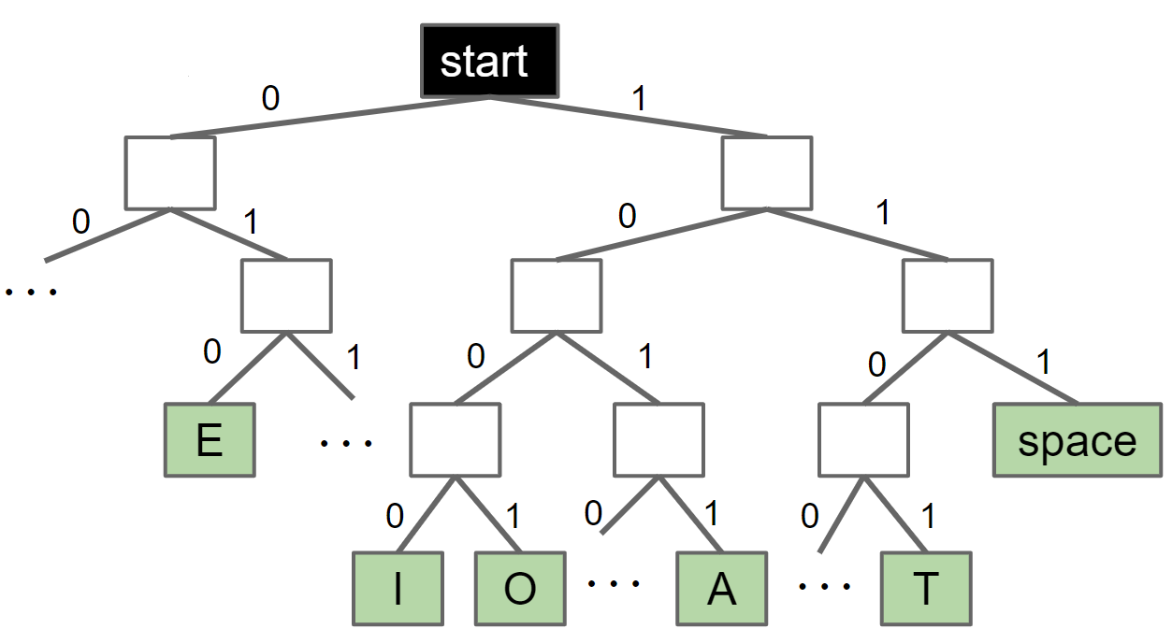
Prefix-Free Codes
Question: For decoding (compressed bitstream back to bitstream), what is a natural data structure to use?
We need to look up longest matching prefix, an operation that Tries excel at.
space | 1
E | 01
T | 001
A | 0001
O | 00001
I | 000001
...
space | 111
E | 010
T | 1101
A | 1011
O | 1001
I | 1000
... | 0111
I ATE: 0000011000100101
I ATE: 100011110111101010

Slide 33
Prefix-Free Codes
Question: For decoding (compressed bitstream back to bitstream), what is a natural data structure to use?
We need to look up longest matching prefix, an operation that Tries excel at.
space | 1
E | 01
T | 001
A | 0001
O | 00001
I | 000001
...
space | 111
E | 010
T | 1101
A | 1011
O | 1001
I | 1000
... | 0111
I ATE: 0000011000100101
I ATE: 100011110111101010

Slide 34
Prefix-Free Codes
Question: For decoding (compressed bitstream back to bitstream), what is a natural data structure to use?
We need to look up longest matching prefix, an operation that Tries excel at.
space | 1
E | 01
T | 001
A | 0001
O | 00001
I | 000001
...
space | 111
E | 010
T | 1101
A | 1011
O | 1001
I | 1000
... | 0111
I ATE: 0000011000100101
I ATE: 100011110111101010

Slide 35
Prefix-Free Codes
Question: For decoding (compressed bitstream back to bitstream), what is a natural data structure to use?
We need to look up longest matching prefix, an operation that Tries excel at.
space | 1
E | 01
T | 001
A | 0001
O | 00001
I | 000001
...
space | 111
E | 010
T | 1101
A | 1011
O | 1001
I | 1000
... | 0111
I ATE: 0000011000100101
I ATE: 100011110111101010

Slide 36
Huffman Coding in Practice

Slide 37
Huffman Compression
Two possible philosophies for using Huffman Compression:
For each input type (English text, Chinese text, images, Java source code, etc.), assemble huge numbers of sample inputs for that category. Use each corpus to create a standard code for English, Chinese, etc.
For every possible input file, create a unique code just for that file. Send the code along with the compressed file.
What are some advantages/disadvantages of each idea? Which is better?
$ java HuffmanEncodePh1 ENGLISH mobydick.txt
$ java HuffmanEncodePh1 BITMAP horses.bmp
$ java HuffmanEncodePh2 mobydick.txt
$ java HuffmanEncodePh2 horses.bmp

Slide 38
Huffman Compression (Your Answers)
Two possible philosophies for using Huffman Compression:
Build one corpus per input type.
For every possible input file, create a unique code just for that file. Send the code along with the compressed file.
What are some advantages/disadvantages of each idea? Which is better?
First one: What if the file has multiple data types, e.g. Chinese and English.
Second one: Individual code is more “secure”.
Second one: Compression for each file requires more work.
Third approach: Try every code, and use the best one.
First approach: Could be faster, because you have already built a code.
If data is not compressible, may as well use #1.
Both allow you to support arbitrary file types.

Slide 39
Huffman Compression (My Answers)
Two possible philosophies for using Huffman Compression:
Build one corpus per input type.
For every possible input file, create a unique code just for that file. Send the code along with the compressed file.
What are some advantages/disadvantages of each idea? Which is better?
Approach 1 will result in suboptimal encoding.
Approach 2 requires you to use extra space for the codeword table in the compressed bitstream.
For very large inputs, the cost of including the codeword table will become insignificant.

Slide 40
Huffman Compression
Two possible philosophies for using Huffman Compression:
For each input type (English text, Chinese text, images, Java source code, etc.), assemble huge numbers of sample inputs for that category. Use each corpus to create a standard code for English, Chinese, etc.
For every possible input file, create a unique code just for that file. Send the code along with the compressed file.
In practice, Philosophy 2 is used in the real world.

Slide 41
Huffman Compression Example [Demo Link]
Given input text: 我我刚刚刚是我是我刚李刚我李是爸李爸李是李我我李刚是我是刚爸是刚我爸我李是是李是我我刚爸是李我我我是爸我是我爸是我爸是我是刚我是爸刚爸我刚我我刚爸我我爸我刚爸爸李李李李我我爸李我我刚爸李我我李我爸我我
Step 1: Count frequencies.
Step 2: Build encoding array and decoding trie.
Step 3: Write decoding trie to output.huf.
Step 4: Write codeword for each symbol to output.huf.
Output bits: 010101010101001…00111111111101…
See optional textbook for how to do this.
1
0
1
0
0
1
0
1
我
爸
是
李
刚
0.35
0.17
0.17
0.16
0.15
Decoding Trie
Codewords
Decoding Trie

Slide 42
Huffman Decompression Example [Demo Link]
Given input bitstream: 010101010101001…00111111111101…
Step 1: Read in decoding trie.
Step 2: Use codeword bits to walk down the trie, outputting symbols every time you reach a leaf.
Note: Symbols are really just bits!
我 is 111001011000100010010001 in Unicode.
“Outputting 我” actually means outputting these 32 bits.
Output symbols: 我我刚刚刚是…
Output bits: 111001011000100010010001...
Decoding Trie
Codewords
1
0
1
0
0
1
0
1
我
爸
是
李
刚
0.35
0.17
0.17
0.16
0.15

Slide 43
Huffman Coding Summary
Given a file X.txt that we’d like to compress into X.huf:
Consider each b-bit symbol (e.g. 8-bit chunks, Unicode characters, etc.) of X.txt, counting occurrences of each of the 2^{b} possibilities, where b is the size of each symbol in bits.
Use Huffman code construction algorithm to create a decoding trie and encoding map. Store this trie at the beginning of X.huf.
Use encoding map to write codeword for each symbol of input into X.huf.
To decompress X.huf:
Read in the decoding trie.
Repeatedly use the decoding trie’s longestPrefixOf operation until all bits in X.hug have been converted back to their uncompressed form.
See Huffman.java for an example implementation on 8-bit symbols.

Slide 44
Compression Theory

Slide 45
Compression Algorithms (General)
The big idea in Huffman Coding is representing common symbols with small numbers of bits.
Many other approaches, e.g.
Run-length encoding: Replace each character by itself concatenated with the number of occurrences.
Rough idea: XXXXXXXXXYYYYXXXXX -> X10Y4X5
LZW: Search for common repeated patterns in the input. See extra slides.
General idea: Exploit redundancy and existing order inside the sequence.
Sequences with no existing redundancy or order may actually get enlarged.

Slide 46
Comparing Compression Algorithms
Different compression algorithms achieve different compression ratios on different files.
We’d like to try to compare them in some nice way.
To do this, we’ll need to refine our model from slide 3 to be a bit more sophisticated.
Let’s start with a straightforward puzzle.

Slide 47
SuperZip
Suppose an algorithm designer says their algorithm SuperZip can compress any bitstream by 50%. Why is this impossible?

Slide 48
Universal Compression: An Impossible Idea
Argument 1: If true, they’d be able to compress any bitstream down to a single bit. Interpreter would have to be able to do the following (impossible) task for ANY output sequence.
01010101000001010101110
101010100001
111001
Compression
Compression
Compression
1
Compression
00
Compression
101
1
00
101
111001
101010100001
01010101000001010101110

Slide 49
Universal Compression: An Impossible Idea
Argument 2: There are far fewer short bitstreams than long ones. Guaranteeing compression even once by 50% is impossible. Proof:
There are 2¹⁰⁰⁰ 1000-bit sequences.
There are only 1+2+4+...+2⁵⁰⁰ = 2⁵⁰¹ - 1 bit streams of length ≤ 500.
In other words, you have 2¹⁰⁰⁰ things and only 2⁵⁰¹ - 1 places to put them.
Of our 1000-bit inputs, only roughly 1 in 2⁴⁹⁹ can be compressed by 50%!

Slide 50
A Sneaky Situation
Universal compression is impossible, but the following example implies that comparing compression algorithms could still be quite difficult.
Suppose we write a special purpose compression algorithm that simply hardcodes small bit sequences into large ones.
Example, represent GameOfThronesSeason6-Razor1911-Rip-Episode1.mp4 as 010.
Compressed Bits
8927472560 bits
Decompression
Algorithm C⁻¹
010
00000000001111111111...
3 bits
GameOfThronesSeason6-Razor1911-Rip-Episode1.mp4

Slide 51
A Sneaky Situation
Suppose we write a special purpose compression algorithm that simply hardcodes small bit sequences into large ones.
Example, represent GameOfThronesSeason6-Razor1911-Rip-Episode1.mp4 as 010.
To avoid this sort of trickery, we should include the bits needed to encode the decompression algorithm itself.
Compressed Bits
8927472560 bits
Decompression
Algorithm C⁻¹
010
00000000001111111111...
3 bits
GameOfThronesSeason6-Razor1911-Rip-Episode1.mp4
8927472707 bits

Slide 52
Compression Model #2: Self-Extracting Bits
As a model for the decompression process, let’s treat the algorithm and the compressed bitstream as a single sequence of bits.
If you want a concrete idea to hold on to, imagine storing the compressed bitstream as a byte[] variable in a .java file. We’ll show an example on the coming slides involving compressing an image.
Can think of the algorithm + compressed bitstream as an input to an interpreter. Interpreter somehow executes those bits (see 61A)
At the very “bottom” of these abstractions is some kind of physical machine (see 61C).
GameOfThronesSeason6-Razor1911-Rip-Episode1.mp4
0111000001110101...
Interpreter
0100001001001101...
SelfExtractingGoT.java
8,927,472,560 bits
8,927,472,707 bits

Slide 53
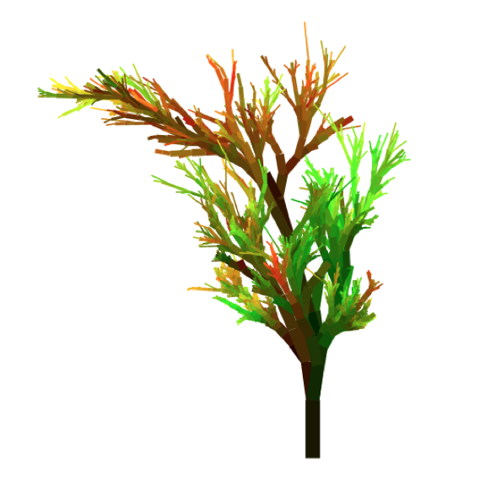
HugPlant
Huffman Coding can be used to compress any data, not just text. In bitmap format, the plant below is simply the stream of bits shown on the right.
Original Uncompressed Bits B
42 4d 7a 00 10 00 00 00 00 00 7a 00 00 00 6c 00 00 00 00 02 00 00 00 02 00 00 01 00 20 00 03 00 00 00 00 00 10 00 12 0b 00 00 12 0b 00 00 00 00 00 00 00 00 00 00 00 00 ff 00 00 ff 00 00 ff 00 00 00 00 00 00 ff 01 00 00 00 00 00 00 00 00 00 00 00 01 00 00 00 00 00 00 00 00 00 00 00 01 00 ...
Total: 8389584 bits

Slide 54
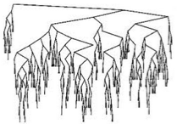
HugPlant Compressed
42 4d 7a 00 10 00 00 00 00 00 7a 00 00 00 6c 00 00 00 00 02 00 00 00 02 00 00 01 00 20 00 03 00 00 00 00 00 10 00 12 0b 00 00 12 0b 00 00 00 00 00 00 00 00 00 00 00 00 ff 00 00 ff 00 00 ff 00 00 00 00 00 00 ff 01 00 00 00 00 00 00 00 00 00 00 00 01 00 00 00 00 00 00 00 00 00 00 00 01 00 ... Total: 8389584 bits
Huffman.java
compress()
74 68 65 20 70 61 73 73 63 6F 64 65 20 69 73 20 68 75 67 39 31 38 32 37 78 79 7A 2E 65 75 7a c0
09 eb cd d4 2a 55 9f d8 98 d1 4e e7 97 56 58 68
0c 7a 43 dd 80 00 7b 11 58 f4 75 73 77 bc 26 01
e0 92 28 ef 47 24 66 9b de 8b 25 04 1f 0e 87 bd
87 9e 03 c9 f1 cf ad fa 82 dc 9f a1 31 b5 79 13
9b 95 d5 63 26 8b 90 5e d5 b0 17 fb e9 c0 e6 53
c7 cb dd 5f 77 d3 bd 80 f9 b6 5e 94 aa 74 34 3a
a9 c1 ca e6 b8 9c 60 ab 36 3b a5 8a b4 3a 5c 5a
62 e9 2f 16 4c 34 60 6e 51 28 36 2c e7 4e 50 be
c0 15 1b 01 d9 c0 bd b4 20 87 42 be d4 e2 23 a2
b6 84 22 4c cf 74 cd 4f 23 06 54 e6 c2 0f 2d bd
e5 81 f4 c6 de 15 59 f1 68 a4 a5 88 16 b0 7f bf
8a 1d 98 bd 33 b4 d5 71 22 93 81 af e0 cc ce 12
57 23 62 3a e4 3d 8c f1 12 8d a5 40 3b 70 d6 9b
12 49 62 8d 6f d4 52 f6 7f d5 11 7c ca 07 dd e3
dc 1c 7f c4 a4 69 77 6e 5e 60 db 5a 69 01 95 c8
d7 2e 57 62 b7 8e 5c 51 f9 70 55 1b 7c ba 68 bc
Total: 1994024 bits
00 20 00 f4 c3 b7 6d c2 31 24 92 dc 24 a7 c9 25 ae 24 b5 c4 85 88 40 be c4 92 46 25 79 2f c4 af 25 f8 92 49 24 92 64 c9 92 49 30 b1 24 92 49 24 2c 49 24 92 49 0b 12 49 24 92 42 c4 92 49 24 92 49 ff ff ff ff ff ff ff ff ff ff ff ff ff ff ff ff ff ff ff ff ff ff ff ff ff ff ff ff ff ff ff ff ff ff ff ff ff ff ff ff ff ff ff ff ff ff ff ff ff ff ff ff ff ff ff ff ff ff ff ff ff ff ff ff ff ff ff ff ff ff ff ff ff ff ff ff ff ff ff ff ff ff ff ff ff ff ff ff ff ff ff ff ff ff ff ff ff ff ff ff ff ff ff ff ff ff ff ff ff ff ff ff ff ff ff ff ff ff ff ff ff ff ff ff ff ff ff ff ff ff ff ff ff ff ff ff ff ff ff ff ff ff ff ff ff ff ff ff ff ff ff ff ff ff ff ff ff ff ff ff ff ff ff ff ff ff ff ff ff ff ff ff ff ff ff ff ff ff ff ff ...
Image data: 1991464 bits
Decoding Trie: 2560 bits

Slide 55
Compression Model #2: Self-Extracting Bits
To keep things conceptually simpler, let’s package the compressed data plus decoder into a single self-extracting .java file.
Bitstream on the left generates bitstream on the right.
SelfExtractingHugPlant.java
HugPlant.bmp
70 75 62 6c 69 63 20 63 6c 61 73 73 20 53 65 6c 66 45 78 74 72 61 63 74 69 6e 67 48 75 67 50 6c 61 6e 74 20 7b 0d 0a ... 74 68 65 20 70 61 73 73 63 6F 64 65 20 69 73 20 68 75 67 39 31 38 32 37 78 79 7A 2E 65 75 7a c0 09 eb cd d4 2a 55 9f d8 98 d1 4e e7 97 56 58 68 0c 7a 43 dd 80 00 7b 11 58 f4 75 73 77 bc 26 01 e0 92 28 ef 47 24 66 9b de 8b 25 04 1f 0e 87 bd 87 9e 03 c9 f1 cf ad fa 82 dc 9f a1 31 b5 79 13 9b 95 d5 63 26 8b 90 5e d5 b0 17 fb e9 c0 e6 53 c7 cb dd 5f 77 d3 bd 80 f9 b6 5e 94 aa 74 34 3a ... 00 20 00 f4 c3 b7 6d c2 31 24 92 dc 24 a7 c9 25 ae 24 b5 c4 85 88 40 be c4 92 46 25 79 2f c4 af 25 f8 92 49 24 92 64 c9 92 49 c4 92 49 24 92 49 ff ff ff ff ff ff ff ff ff ff ff ff ff ff ff ff ff ff ff ff ff ff ff ff ff ff ff ff ff ff ff ff ff ff ff ff ff ff ff ff ff ff ff ff ff ff ff ff ff ff ff ...
42 4d 7a 00 10 00 00 00 00 00 7a 00 00 00 6c 00 00 00 00 02 00 00 00 02 00 00 01 00 20 00 03 00 00 00 00 00 10 00 12 0b 00 00 12 0b 00 00 00 00 00 00 00 00 00 00 00 00 ff 00 00 ff 00 00 ff 00 00 00 00 00 00 ff 01 00 00 00 00 00 00 00 00 00 00 00 01 00 00 00 00 00 00 00 00 00 00 00 01 00 00 00 00 00 00 00 00 00 00 00 01 00 00 00 00 00 00 00 00 00 00 00 00 00 00 00 ff ff ff ff ff ff ff ff ff ff ff ff ff ff ff ff ff ff ff ff ff ff ff ff ff ff ff ff ff ff ff ff ff ff ff ff ff ff ff ff ff ff ff ff ff ff ff ff ff ff ff ff ff ff ff ff ff ff ff ff ff ff ff ff ff ff ff ff ff ff ff ff ff ff ff ff ff ff ff ff ff ff ff ff ff ff ff ff ff ff ff ff ff ff ff ff ff ff ff ff ff ff ff ff ff ff ff ff ff ff ff ff ff ff ff ff ff ff ff ff ff ff ff ff ff ff ff ff ff ff ff ff ff ff ff ff ff ff ff ff ff ff ff ff ff ff ff ff ff ff ff ff ff ff ff ff ff ff ff ff ff ff ff ff ff ff ff ff ff ff ff ff ff ff ff ff ff ff ff ff ff ff ff ff ff ff ff ff ff ff ff ff ff ff ff ff ff ff...
2,037,424 bits
8,389,584 bits

Slide 56
Compression Model #2: Self-Extracting Bits
As a model for the decompression process, let’s treat the algorithm and the compressed bitstream as a single sequence of bits.
We’ve now seen an example: SelfExtractingHugPlant.
Will discuss the implications of this model next time.
HugPlant.bmp
0111000001110101...
Interpreter
0100001001001101...
SelfExtractingHugPlant.java
8,389,584 bits
2,037,424 bits

Slide 57
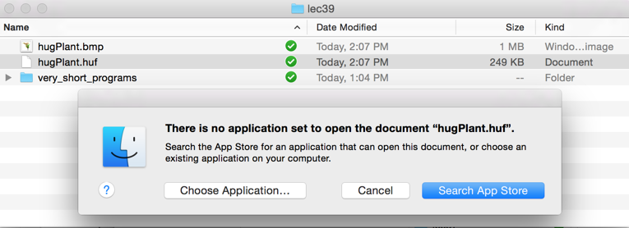
Opening a .huf File
Of course, major operating systems have no idea what to do with a .huf file.
Have to send over the 43,400 bits of Huffman.java code as well.
Total size (including .java file): 2,037,424 bits.
This is an alternate justification for using compression model #2.

Slide 58
LZW Style Compression (Extra)

Slide 59
Thought Experiment
How might we compress the following bitstreams (underlines for emphasis only)?
B=”aababcabcdabcdeabcdefabcdefgabcdefgh”?
B=”abababababababababababababababab”?
B=”aaaaaaaaaaaaaaaaaaaaaaaaaaaaaaaaa”?

Slide 60
The LZW Approach
Key idea: Each codeword represents multiple symbols.
Start with ‘trivial’ codeword table where each codeword corresponds to one ASCII symbol.
Every time a codeword X is used, record a new codeword Y corresponding to X concatenated with the next symbol.
Demo Example: http://goo.gl/68Dncw

Slide 61

LZW
Named for inventors Limpel, Ziv, Welch.
Related algorithm used as a component in many compression tools, including .gif files, .zip files, and more.
Once a hated algorithm because of attempts to enforce licensing fees. Patent expired in 2003.
Our version in lecture is simplified, for example:
Assumed inputs were ≤ 0x7f (7 bit input) and also provided 8 bit outputs (real LZW can have variable length outputs).
Didn’t say what happens when table is full (many variants exist).

Slide 62
LZW
Neat fact: You don’t have to send the codeword table along with the compressed bitstream.
Possible to reconstruct codeword table from C(B) alone.
LZW decompression example:
http://goo.gl/fdYU9C

Slide 63
Lossy Compression (Extra)

Slide 64
Lossy Compression
Most media formats lose information during compression process:
.JPEG images.
.MP3 audio.
.MP4 video.
Why?
MP4 video: 1920 x 1080 pixels, 60 times per second, 24 bits per pixel: 0.37 gigabytes per second, 1,343 gigabytes per hour.
Downloading a movie: 30 days at 1 MB/second.

Slide 65
Lossy Compression
Basic idea: Throw away information that human sensory system doesn’t care about.
Examples:
Audio: High frequencies.
Video: Subtle gradations of color (low frequencies).
See EE20 (or perhaps 16A/16B?) for more.

Slide 66
Summary
Compression: Make common bitstreams more compact.
Huffman coding:
Represents common symbols as codeword with fewer bits.
Uses something like Map<Character, BitSeq> for compression.
Uses something like TrieMap<Character> for decompression.
LZW:
Represents multiple symbols with a single codeword.
Uses something like TrieMap<Integer> for compression.
Uses something like Map<Character, SymbolSeq> for decompression.

